Slide 1

ExPeRT
Exploration Preparation, Research & Technology
Exploration Technologies for Future Missions
Advanced Space Technologies in Robotics and Automation (ASTRA)
20 October 2023
HRE-E (J. Alves)
Email: jorge.alves@esa.int

Slide 2
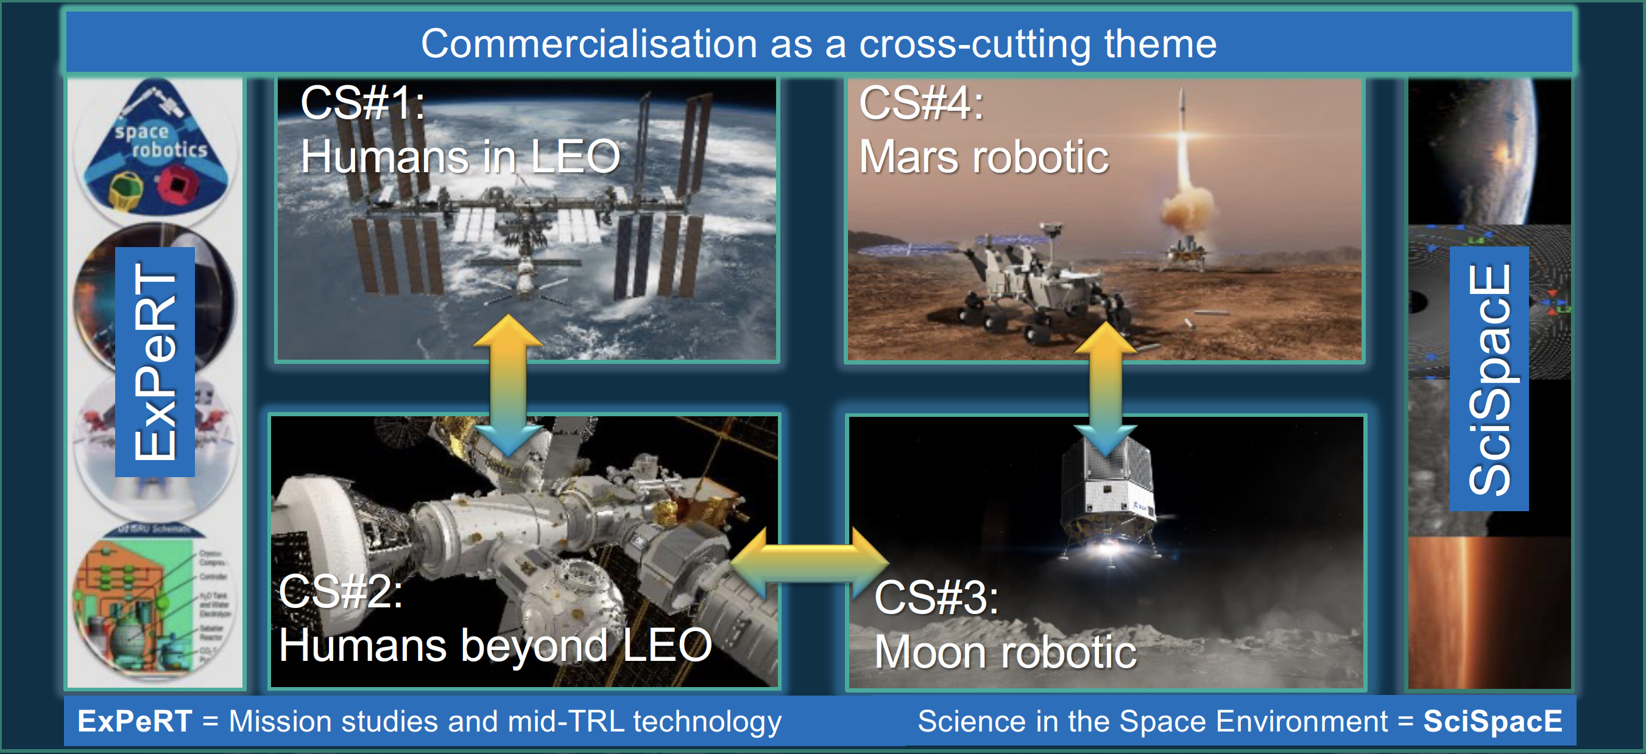
E3P – European Exploration Envelope Programme

Slide 3

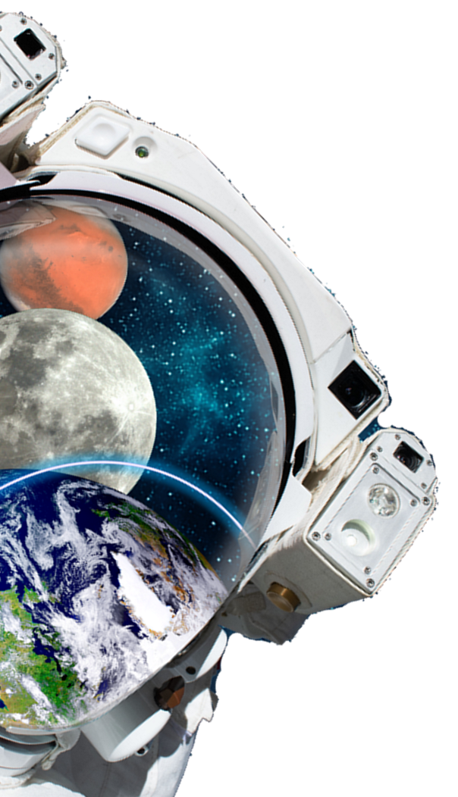


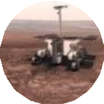
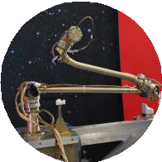




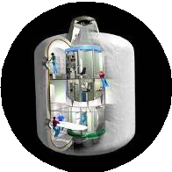



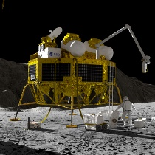



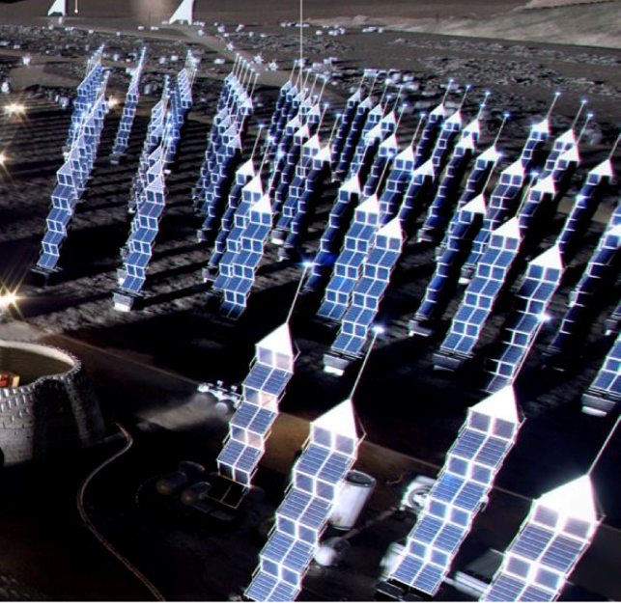

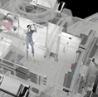


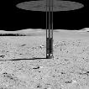
TERRAE NOVAE 2030+
Notional Strategy Roadmap
2020 > 2030
ESA in mutual inter-dependence
2030 > 2040
European-led capabilities
ExoMars
TGO
EDL and Rosalind Franklin rover
Sample Transfer Arm & Earth Return Orbiter
Mars Sample Return
Comms&Nav Heavy Cargo&Astrobiology Crew Habitation
Preparing to send humans to Mars
European Service Module
Deep space human transportation
Gateway
Deep space habitation & refuelling & communications
Cargo logistics/mobility Science activities Power Station
Living and working on the Moon
Core ISS Partner
Contribution
Commercial Stations
Cargo up/down Human transportation
Enabling capabilities - Inspirator

Slide 4

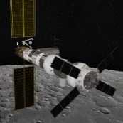
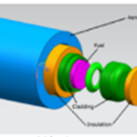

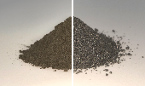
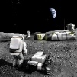
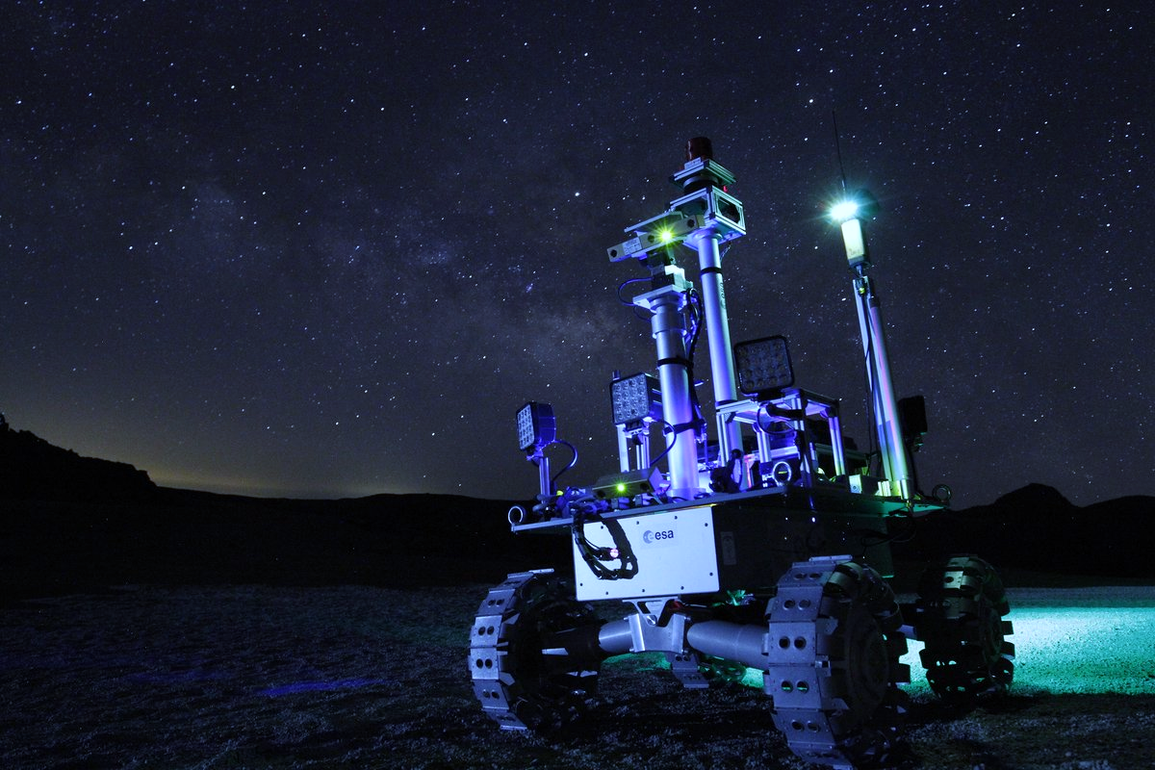
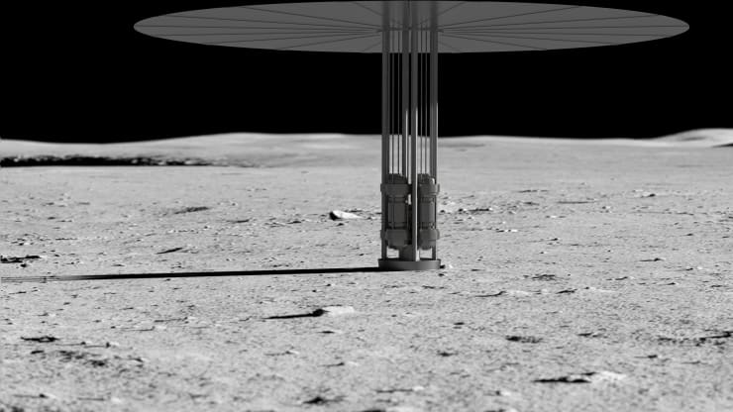
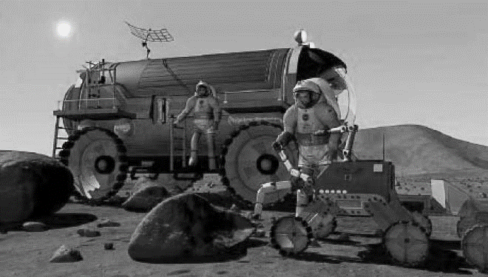
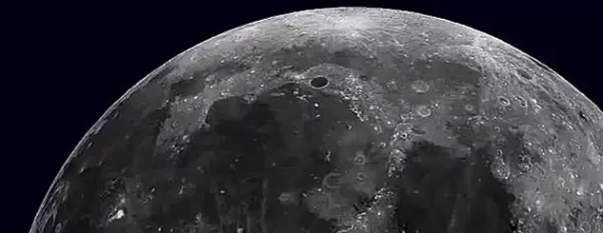
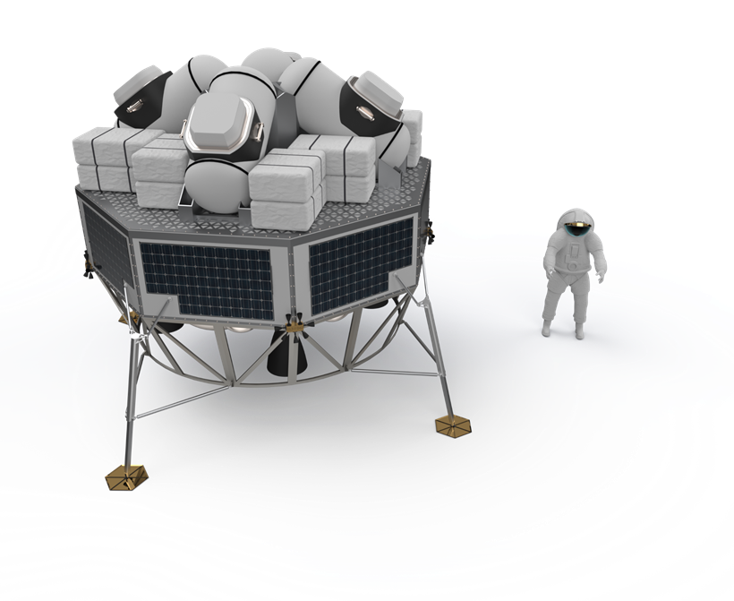
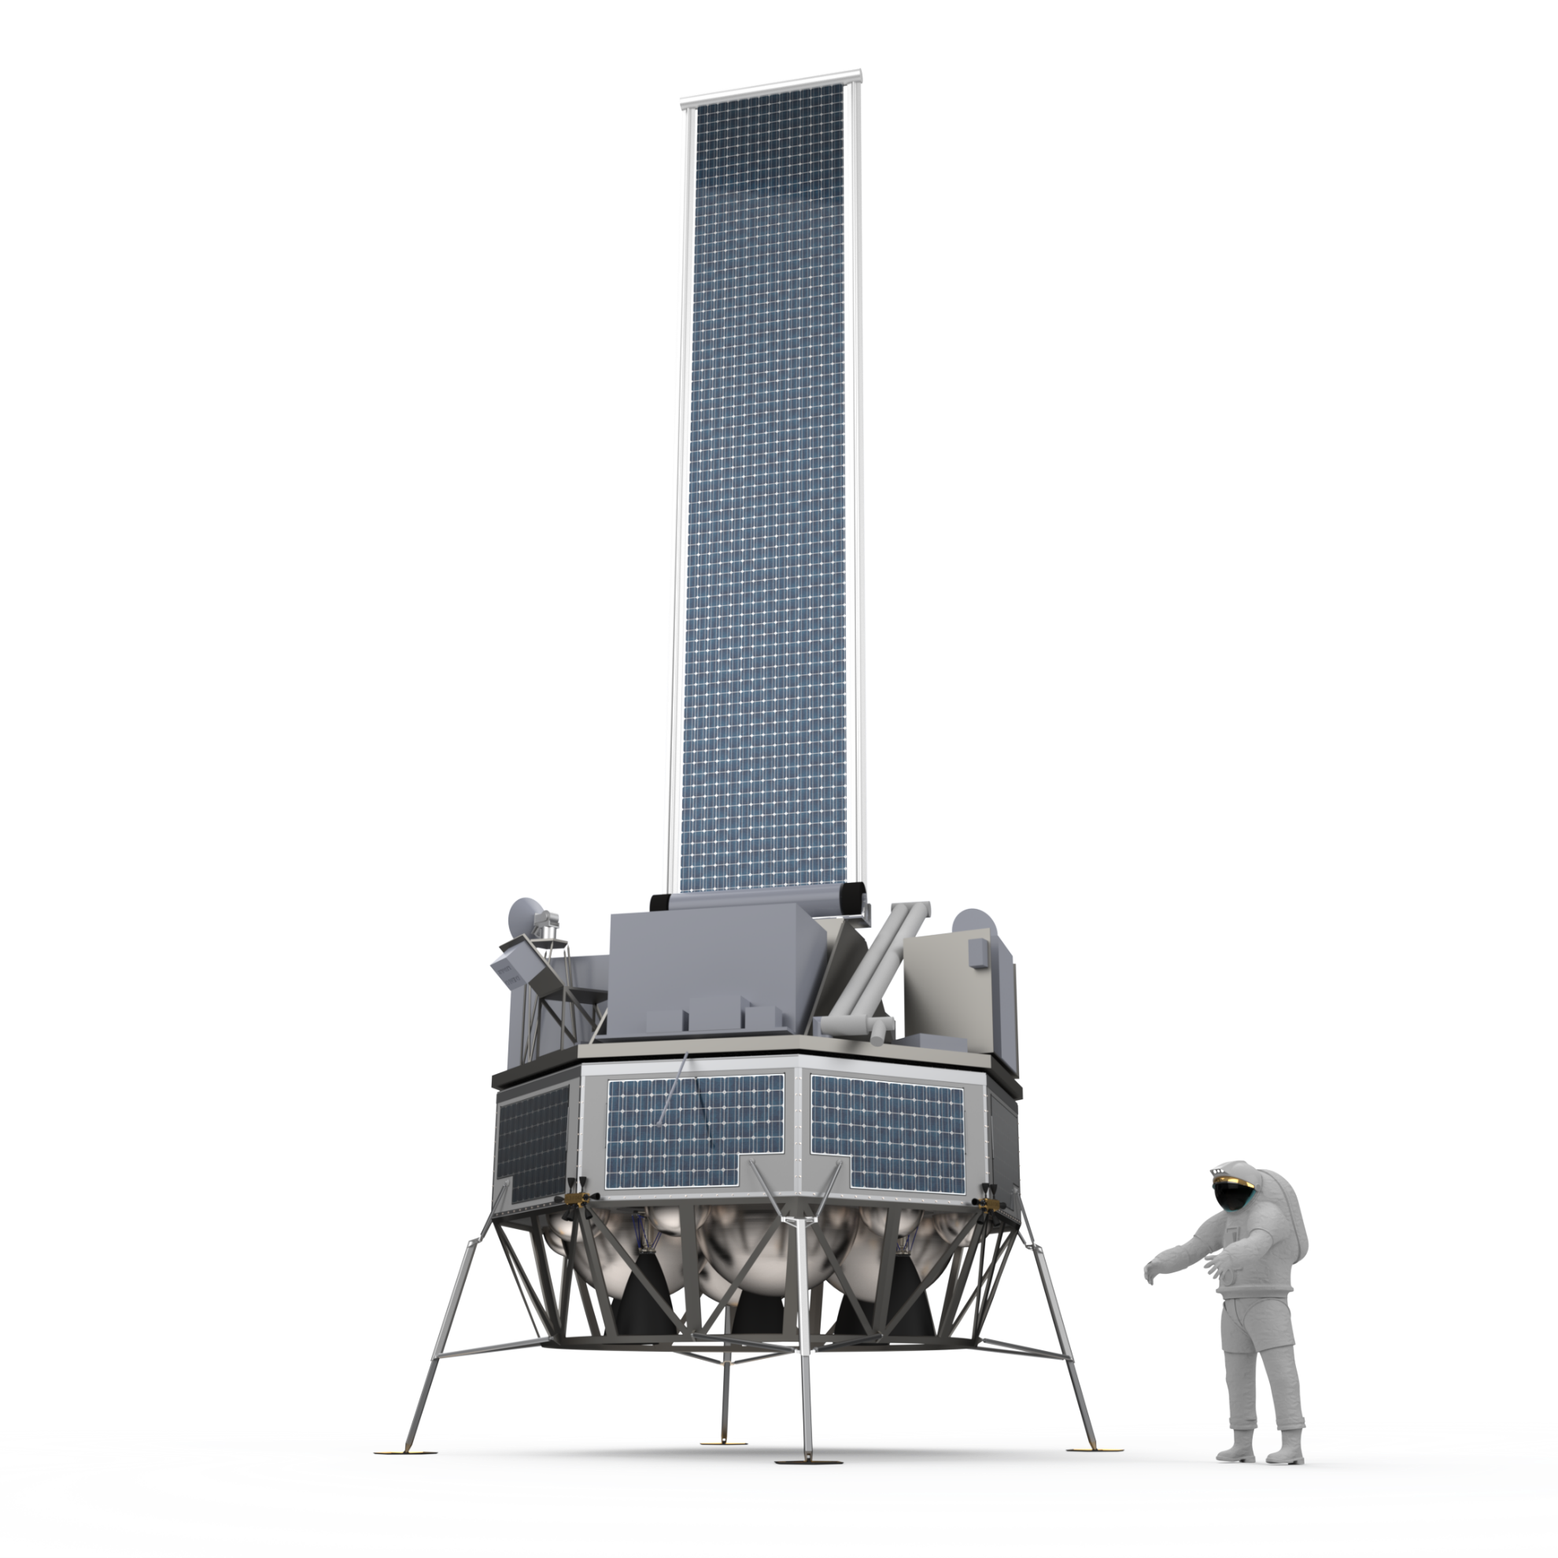
Notional Strategy Roadmap Mission Concepts
Moon
Communication & Navigation, Gateway utilisation, RPS, analogues, exploration tools
Large science mission & mobility platform
ISRU pilot plant & excavation
Cargo, science
& ISRU demo
Power & comms station
Surface habitat or pressurized rover
European surface transportation (EL3/Argonaut) supporting science, cargo/utilities for human missions & infrastructure deployment

Slide 5
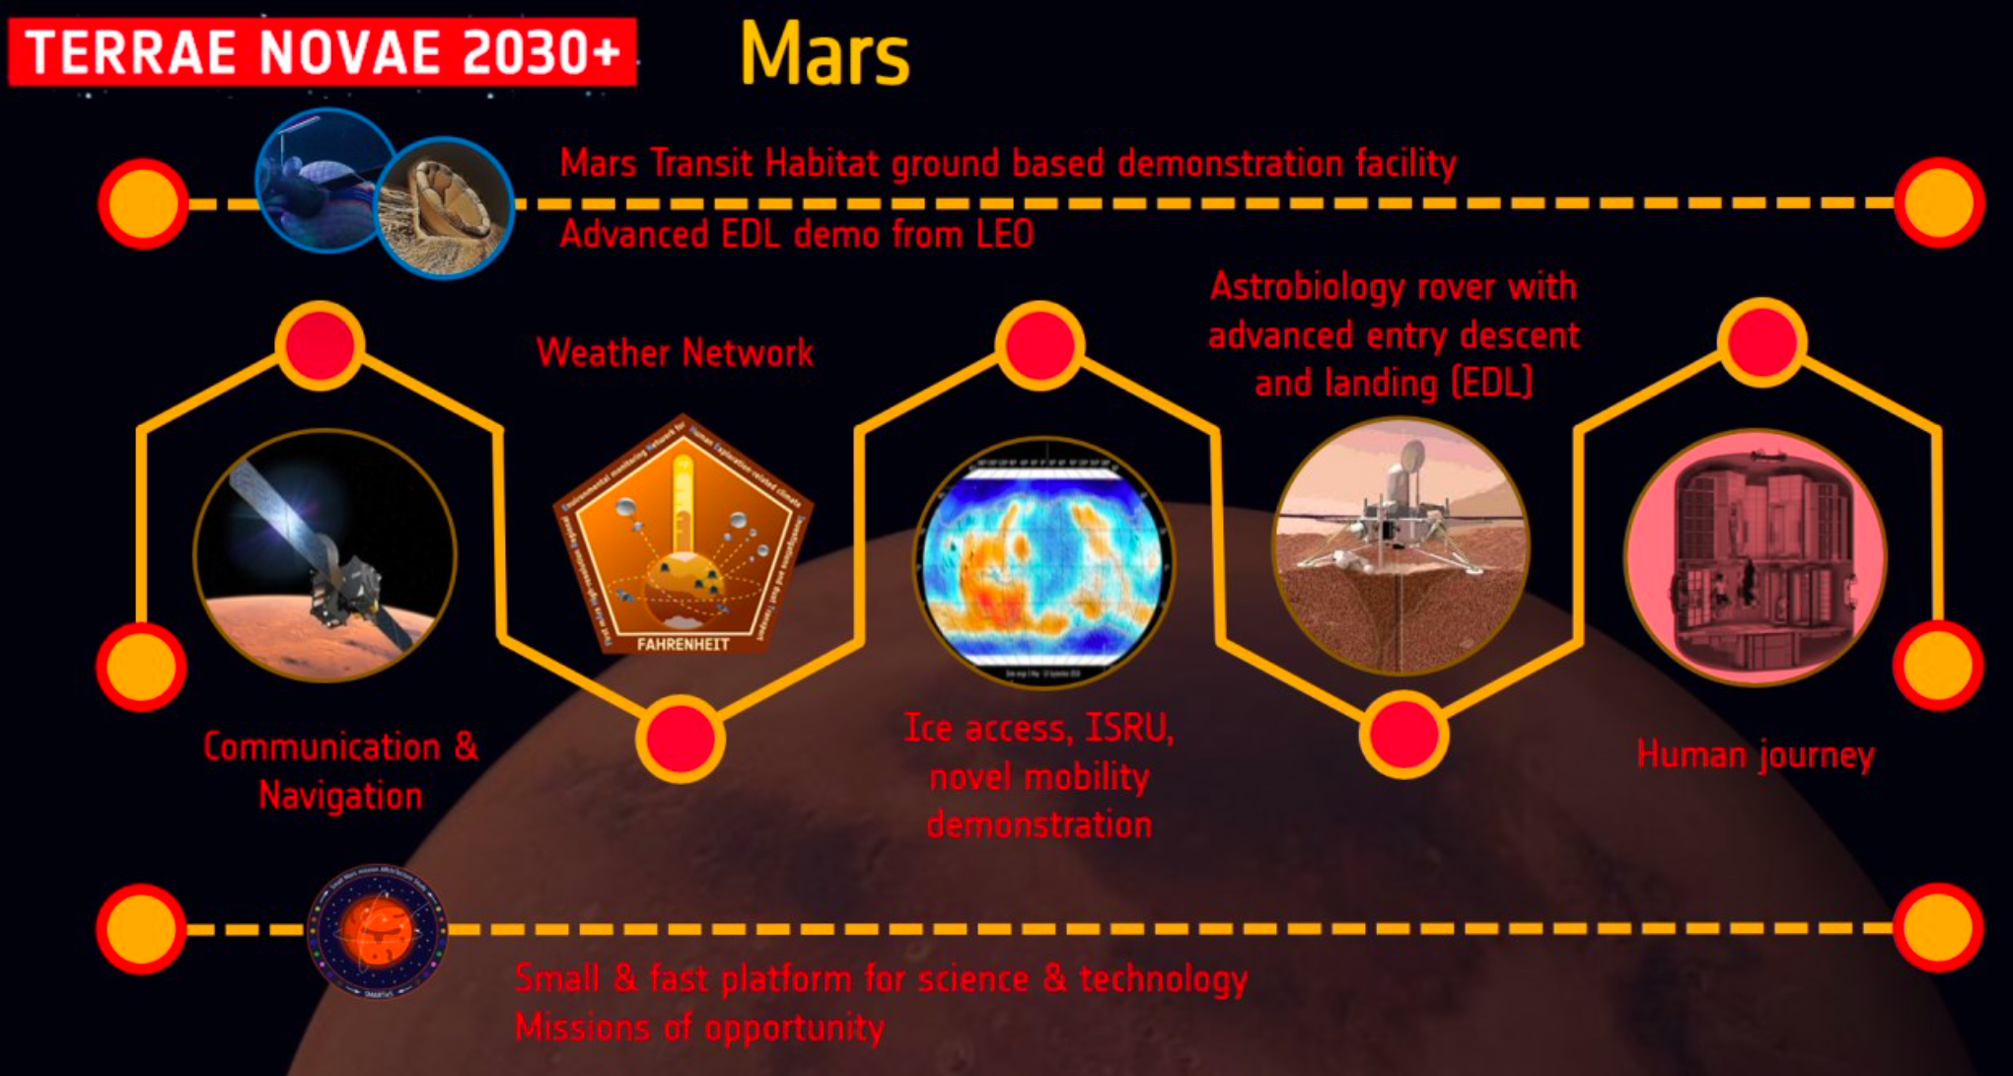
Notional Strategy Roadmap Mission Concepts

Slide 6
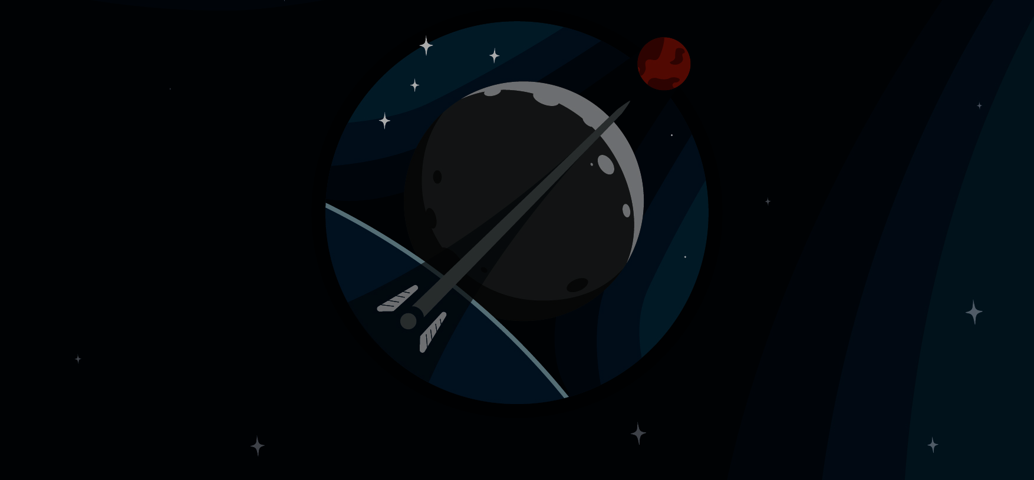

Exploration Preparation Research and Technology (ExPeRT)
By preparing the future, ExPeRT is an enabling element for implementing the Terrae Novae 2030+ strategy
ExPeRT has the mandate to:
  Prepare & de-risk future exploration missions, projects and associated technologies (Phase-0, Pre-Phase A, Phase A/B1);
  Raise critical technologies to TRL5 to facilitate selection and development of new exploration missions and projects;
  Contribute to new international partnerships (both existing and new partners) to create future exploration opportunities;
Hence allowing Europe to be flexible and to adapt to a fast-evolving international exploration context
Note: Visit the ExPeRT webpage at www.esa.int/expert (feedback is welcome!)

Slide 7
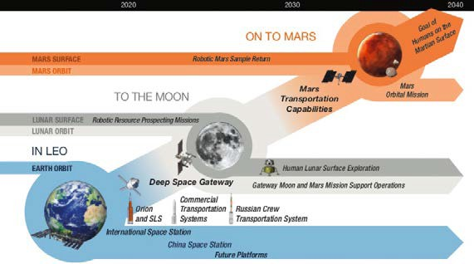
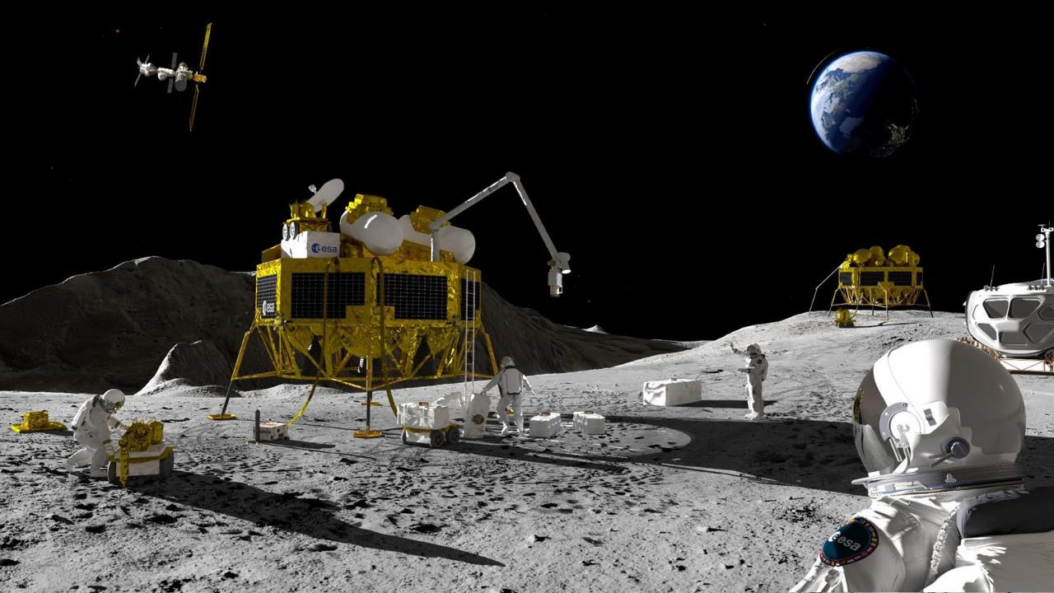
Exploration Technology Activities
Technology-push activities
Foster innovation and ideas from technical experts in ESA
Potential for step-change or breakthrough (even disruption) in existing technologies and products
Contributes to long-term performance targets, capability building
Mission-pull technology activities
Application focused
Responds to a specific identified exploration mission need
Requirements are derived from completed mission studies
Performance verification
Credit: ISECG/Global Exploration Roadmap

Slide 8
Exploration Technology Requirements
HRE coordinates technology activities for Exploration with relevant ESA Directorates
A fundamental element of this coordination process is represented by the timely definition of adequate user needs and technology requirements for future exploration missions
ExPeRT provides technology-push and mission-pull technology requirements (TRQ) on annual basis
Technology-push requirements defined by ExPeRT, are coordinated with ESA Competence Domain Leaders
Mission-pull technology requirements in 2021, 2022, and 2023 were defined by ExPeRT for the TDE workplan based mainly on mission concept studies run at ESA’s Concurrent Design Facility
The Exploration Technology Compendium provides an overview of activities in its main funding pillars:
Discovery and Spaceships TRL1 → TRL3 (Innovation and blue-sky research) – not yet in the Compendium
TDE TRL2 →TRL4 (technology-push or mission-pull technology developments)
GSTP TRL3 → TRL9 (product competitiveness or market-push)
ExPeRT TRL3 → TRL5/6 (programme/mission-pull technology developments or core capability maturation)

Slide 9
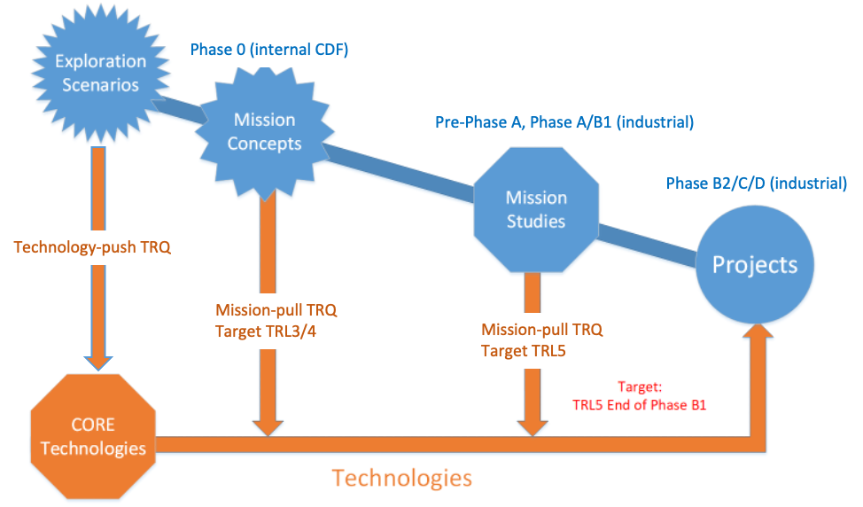
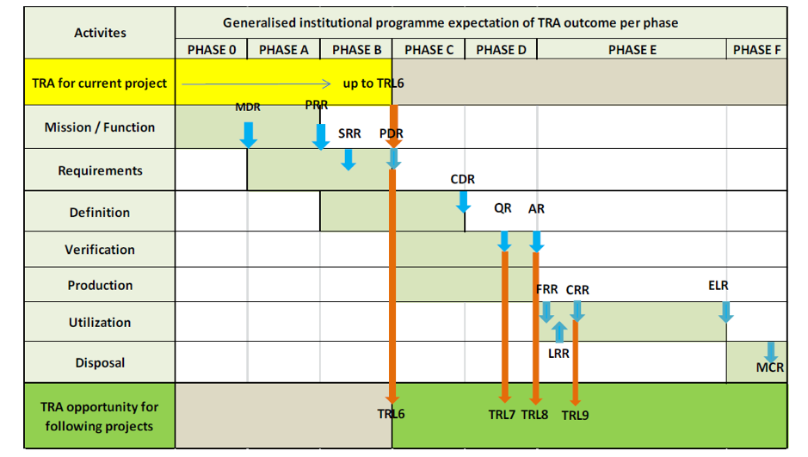
Technologies for Exploration
16 Technology Areas
Propulsion
Novel Energy Systems
Robotics and Mechanisms
Artificial Intelligence Applications
Advanced Life Support Systems
In-Situ Manufacturing
Crew Health Management
Space Resources Utilisation*^{roadmap}
Radiation & Environmental Effects
Communication and Navigation
Subsurface Sampling/Deep Drilling
Guidance, Navigation and Control
Avionics
(re-)Entry, Descent and Landing
Thermal Control Systems
Mission Operations Data Systems
Timely development of critical technologies essential to achieve optimum cost
ESA requires TRL5 for new technologies by end of system Phase B1
Principle of maximising open competition for the excellence of the products
Ref. ECSS-E-HB-11A

Slide 10











THE ARGONAUTS ARE COMING!
Lander Descent Element (LDE) Phase A/B1 studies conducted in Period 2
LDE Phase B2/C/D procurement approved at February IPC 2023, ITT issue in March 2023
Engine pre-development to TRL5 proceeding with selection in December 2023
Argonaut Mission 1 to be studied & agreed with NASA by CM25
Current candidates: Logistic cargo, Utility human rover, + ‘hitchhiker’ ESA science/technology
15

Slide 11
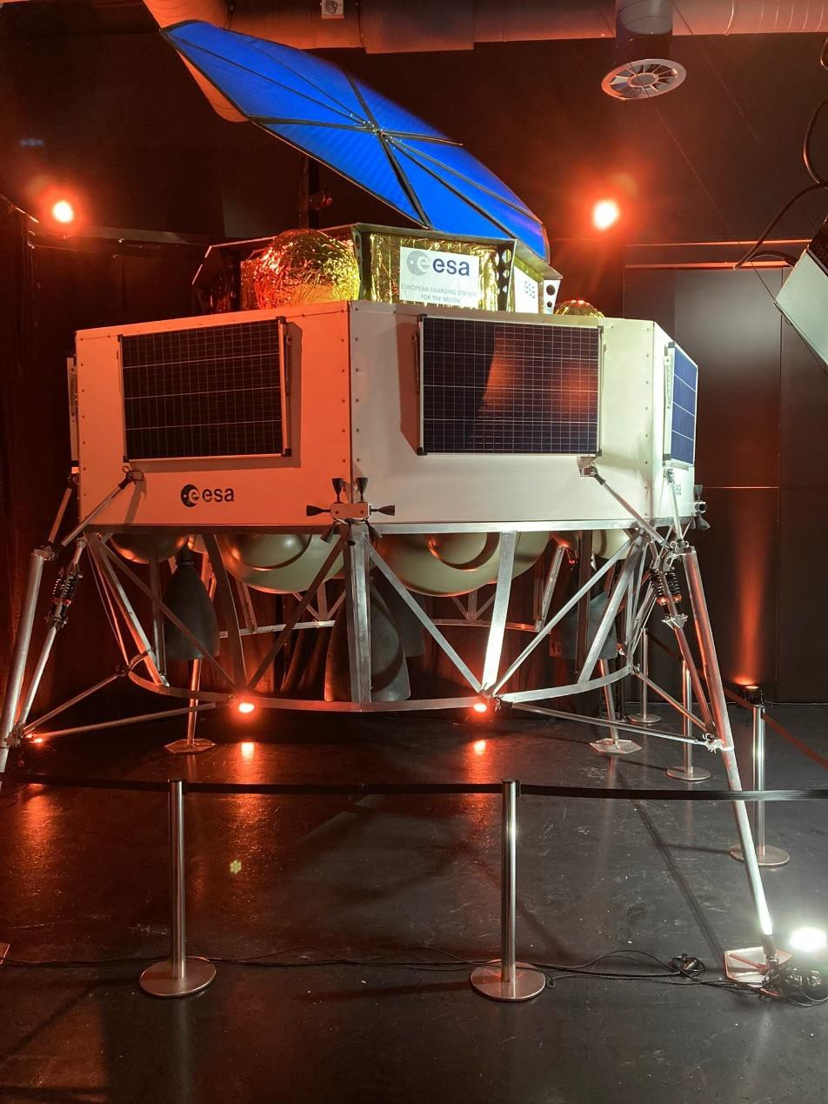
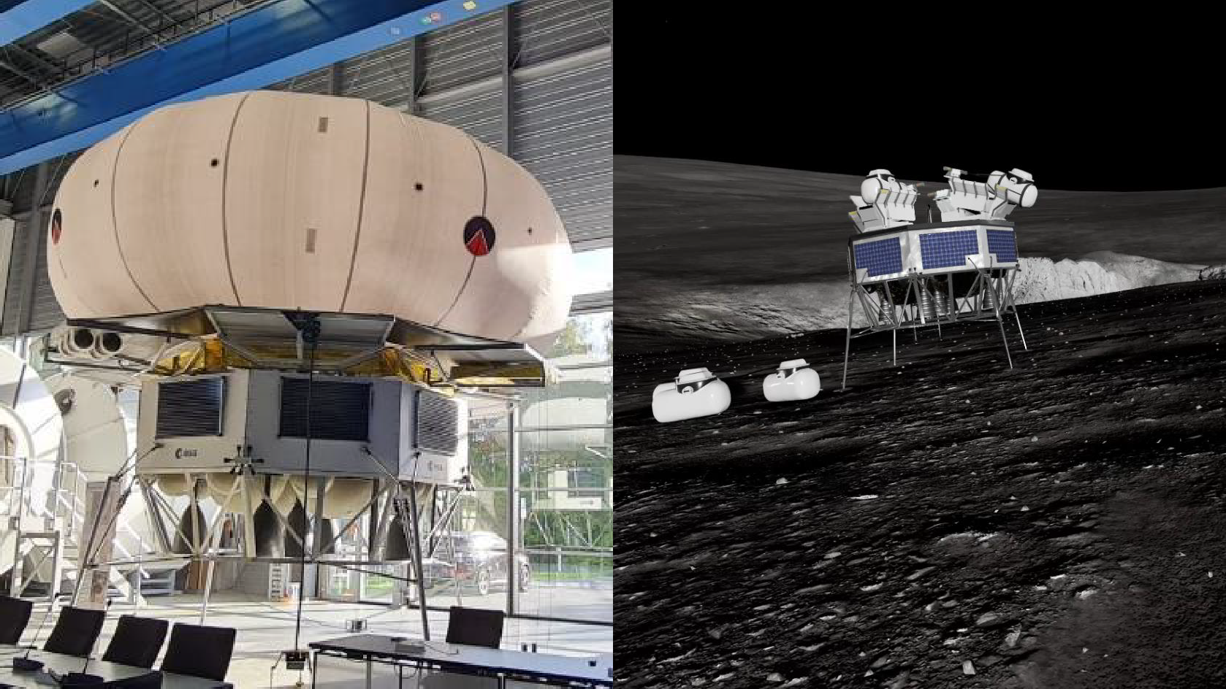
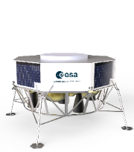
ARGONAUT 1:1 MODEL and VR
Many options for later missions:
    - Cargo and Logistics
    - Scientific missions
    - Power charging station
    - Space resources demonstrator
    - …
1500-1800 kg

Slide 12
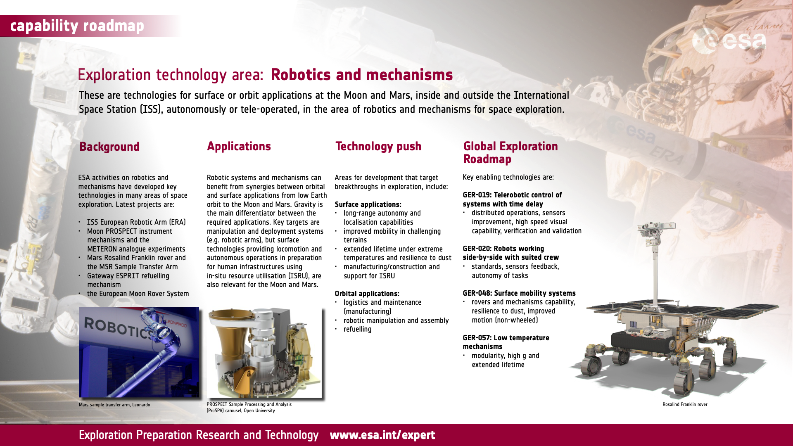

Slide 13
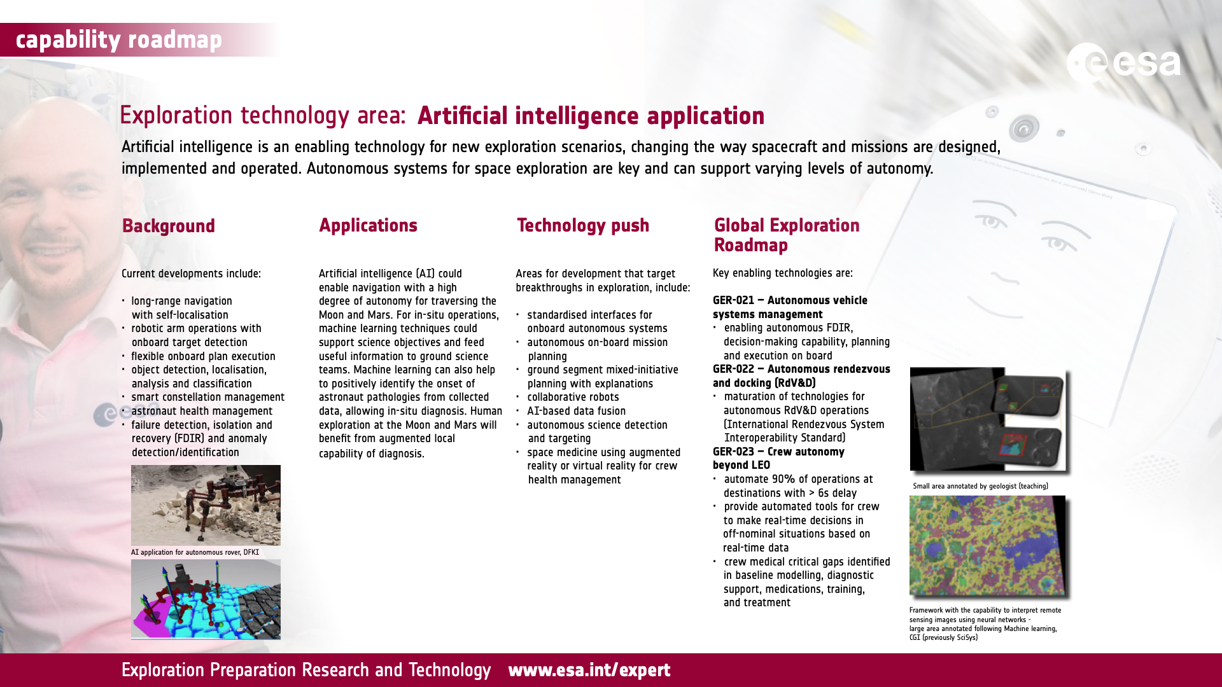

Slide 14
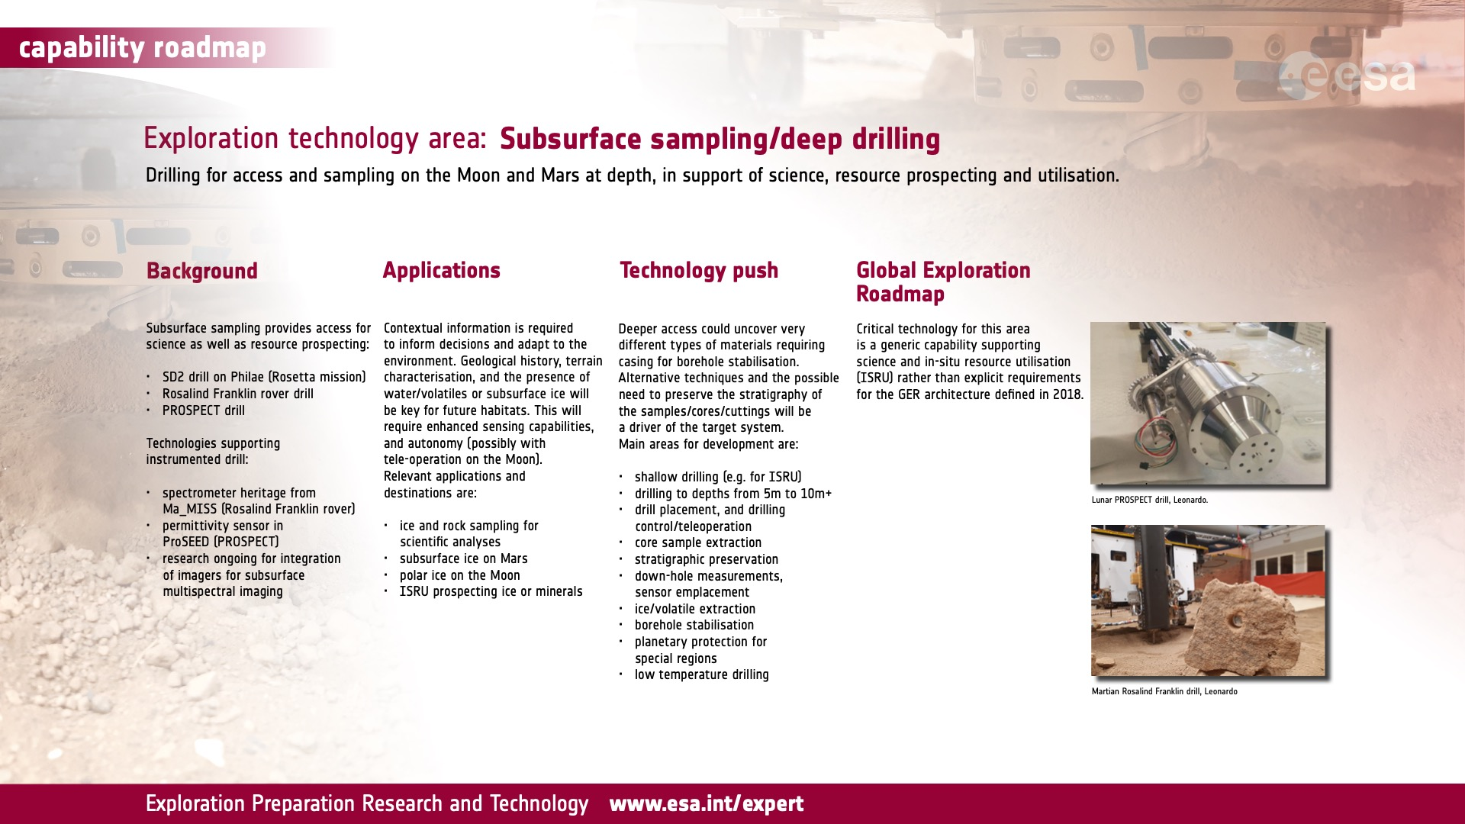

Slide 15
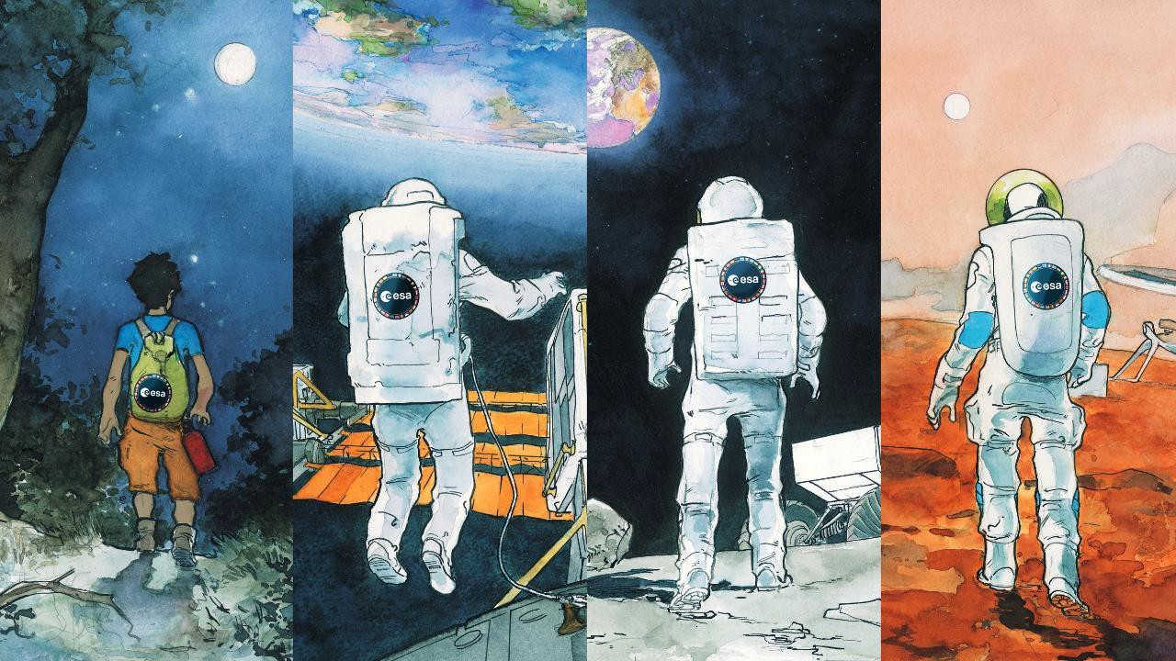
























Thank you for your attention
29

